Slide 1
Poetry Analysis
Mrs. Belof

Slide 2
Poetry Analysis Using the TP-CASTT Method

Slide 3
What is TP CASTT?
An acronym of steps used to analyze poetry. The results of TPCASTT can be used to write an essay.
The TPCASTT process is comprised of 7 steps which should be completed in the order given.

Slide 4
How does TPCASTT work?
The TPCASTT method is used to analyze poetry for some reason specified by the analyst.
The analyst will:
Observe
Interpret
Infer
Analyze
Evaluate

Slide 5
Step 1: Title Goal- Attempt to predict what the poem will be about
Ponder the title before reading the poem.
Questions to ask yourself:
What predictions can I make about the poem
What feelings can I connect to the poem’s title?
Write your response in a complete sentence

Slide 6
Step 2: Paraphrase Goal- Translate the poem, line by line, into your own words.
Paraphrase the literary meaning/plot of the poem. A true understanding of the poem must evolve from comprehension or what’s going on in the poem.

Slide 7
Step 3: Connotation Goal- Contemplate the poem for meaning beyond the literal meaning.
In poetry, connotation indicates that analyst should examine any and all poetic devices, focusing on how such devices contribute to the meaning, the effect, or both of a poem.
Consider imagery, figurative language, symbolism, diction, point of view, and sound devices
You will link these considerations to the overall meaning.

Slide 8
Step 4: Attitude Goal- Observe both the speaker’s and the poet’s attitude
Having examined the poem’s devices and clues closely, now explore the multiple attitudes that may be present in the poem.
Here you will describe the tone of the author and/or speaker. Recall how this is done…

Slide 9
Step 5: Shifts Goal-Note shifts in the speaker’s attitudes or emotions.
Rarely does a poet begin and end the poetic experience in the same place. Discovery of a poet’s understanding of an experience is critical to the understanding of the poem. Trace the feelings of the speaker from the beginning to the end, paying particular attention to the conclusion

Slide 10
Look for the following to find shifts:
1. Key words (but, yet, however, although)
2. Punctuation (dashes, periods, colons, ellipsis) 3. Stanza division
4. Changes in line or stanza length or both
5. Irony (sometimes irony hides shifts)
6. Effect of structure on meaning
7. Changes in sound (rhyme) may indicate changes in meaning
8. Changes in diction (slang to formal language)

Slide 11
Step 6: Title Goal-Examine the title again, this time on an interpretive level
Questions to ask yourself:
Why is the title “_____?”
What does this mean?

Slide 12
Step 7: Theme Goal- Determine what the author is saying and wants me to learn and feel after reading the poem.
Identify the theme by recognizing the human experience, motivation, or condition suggested by the poem
This step, within itself, has a system:
Summarize the plot
List the subject (s) of the poem (moving from literal subjects to abstract concepts such as war, death, discovery)
Determine what the poet is saying about each subject. Write a complete sentence, making a statement and point about the subject (s).

Slide 13
Your turn!!!!
One of my favourite poems of all time is one by the famous poet Robert Frost entitled, “The Road Not Taken”

Slide 14
The Road Not Taken
By Robert Frost 1874–1963 Robert Frost
Two roads diverged in a yellow wood,
And sorry I could not travel both
And be one traveler, long I stood
And looked down one as far as I could
To where it bent in the undergrowth;
Then took the other, as just as fair,
And having perhaps the better claim,
Because it was grassy and wanted wear;
Though as for that the passing there
Had worn them really about the same,
And both that morning equally lay
In leaves no step had trodden black.
Oh, I kept the first for another day!
Yet knowing how way leads on to way,
I doubted if I should ever come back
I shall be telling this with a sigh
Somewhere ages and ages hence:
Two roads diverged in a wood, and I—
I took the one less traveled by,
And that has made all the difference.

Slide 15
TP - CASTT
On a separate sheet of paper follow the TP –CASTT outline using the poem “The Road Not Taken”… let’s see how you do!

Slide 16
WHAT IS THE THEME?
The theme is the general insight or idea about life that the writer wishes to express. As well, it can often be stated in a simple sentence.
Example: After reading this poem, I think the writer wants me to understand…
WHAT IS FIGURATIVE LANGUAGE?
All literature contains figurative language (connotative language); it is the deeper meaning. Figurative language can be broken down into many sub-categories such as, speech, sound and repetition

Slide 17
Types of Rhyme
There are 5 basic types of rhyme:
1. Masculine Rhyme: the rhyming of a single accented syllable (park/dark)
2. Feminine Rhyme (double rhyme): rhyme in which the accented syllables in two words are followed by identical unaccented syllables (turtle/fertile or drifting/lifting)
3. Slant Rhyme (half rhyme, imperfect rhyme, near rhyme): the final sound is the same, but the preceding sound is different (mouth/truth, trees/rows, replied/said)
4. Internal Rhyme: the rhyming of two or more words within a single line of poetry (Edgar Allan Poe’s “Once upon a midnight dreary, while I pondered weak and weary…”
5. End Rhyme: rhyming occurring at the ends of lines
A speak that would have been beneath my sight
On any but a sheet so white - Robert Frost

Slide 18
Rhyme Scheme
is a poet’s deliberate pattern of lines that rhyme with other lines in a poem or stanza. The rhyme scheme, or pattern, can be identified by giving end words that rhyme with each other the same lame.
Twinkle, twinkle, little star, A
How I wonder what you are. A
Up above the world so high, B
Like a diamond in the sky. B
Twinkle, twinkle, little star, A
How I wonder what you are! A
Each time you get to the end of the line, label the rhyme with a letter. By the time you finish the stanza or the poem, you will be able to identify the rhyme scheme.

Slide 19
Poetry with no Rhyme Schemes
Free Verse Poetry – Not all poetry contains a rhyme scheme. If a poem doesn’t have a particular rhyme scheme pattern, it is probably written in free verse. Free verse poetry is free from having to conform to any particular pattern, rule, or convention.
Blank Verse – has a rhythm but no rhyme scheme

Slide 20
Rhyme Schemes
Alternating Couplets – ABAB
Rhyming Couplets - AABB

Slide 21
Figures of Speech
Simile is a figure of speech that makes a connection between two unlike things by using like or as.
Ex. My heart is like a rose.
Ex. Don ate his salad like a vacuum cleaner.
Ex. His arms were weak and felt like noodles.

Slide 22
Standard Metaphor
is a figure of speech that makes a connection between two unlike things. Ex. My heart is a rose.
Ex. The sun is a furnace.
Ex. The smoke was cotton balls billowing from the chimney.

Slide 23
Extended Metaphor
is a metaphor extended over several lines, verses, or chapters.
Ex. Writing this research paper is a grind. My brain is not operating. I am running out of steam. --- > Each sentence extends the metaphor that the mind is a machine.
Ex. "All the world's a stage, and all the men and women merely players; They have their exits and their entrances;
And one man in his time plays many parts,
His acts being seven ages.” (Act II, Scene vii).
As You Like It - William Shakespeare

Slide 24
Personification
is a literary technique that attributes human qualities and characteristics to non-human objects.
Ex. The stars danced playfully in the moonlit sky.
Ex. She did not realize that opportunity was knocking at her door.
Ex. The bees played hide and seek with the flowers as they buzzed from one to another.
Ex. The wind sang through the meadow.
Ex. I could hear Hawaii calling my name.

Slide 25
Hyperbole
is a comparison (like similes and metaphors) but is an extravagant and even ridiculous. The exaggeration is used for emphasis and to prove a point. Hyperboles are not meant to be taken literally.
Ex. I am so hungry I could eat a horse.
Ex. It was so cold I saw polar bears wearing jackets.
Ex. I had a ton of homework.
Ex. I nearly died laughing.
Ex. I tried a thousand times.

Slide 26
Apostrophe
A particular kind of personification in which we address something non-human as if it were human or alive; it is usually capitalized
“The City was sick with disease.”

Slide 27
Oxymoron
Is composed of a pair of neighbouring contradictory words
Biggie small
Tiny giant

Slide 28
Allusion
is a reference to a famous person, place, or event.
Ex. The gold medal winner was a Cinderella story.
Ex. When she lost her job, she acted like a Scrooge, and refused to buy anything that wasn’t necessary

Slide 29
Symbolism
A person, place, object, event or action that represents a deeper meaning

Slide 30
Figures of Sound
Alliteration is the repetition of the same sounds of the same kind of sounds throughout the phrase.
Ex. He helped her hurt head heal.
Ex. Peter Piper picked a peck of pickled peppers.
Ex. And the silken sad uncertain rustling of each purple curtain
Ex. I have stood still and stopped the sound of feet.
Ex. As the wind will bend

Slide 31
Idiom
is a phrase or word that means something different than its literal definition. The word or phrase is meant to be understood figuratively rather than literally. An idiom is not slang because it is known by everyone – not just by a certain group. However, idioms generally only make sense to the languages’ native speakers.
Ex. I can do that blind folded.
Ex. Go out there and break a leg.
Ex. Helen spilled the beans.
Ex. It is raining cats and dogs outside.
Ex. You better not chicken out.

Slide 32
Onomatopoeia
is the formation or use of words to imitate the sounds associated with the objects or actions they refer to.
Ex. Buzz, Murmur, Tick Tock, Zip, Beep, Boom, Yikes, Poof, Eek, choo-choo, hiss, sizzle, vroom, animal noises (moo, purr, quack), etc.

Slide 33
Assonance
Focuses on the repetition of vowel sounds
I play in the bright light of the night
I can draw a kite in this bright light
Even though it’s the middle of the night

Slide 34
Consonance
The repetition of consonant sounds that is not limited to the beginning of the words
Peter Piper picked a peck of pickled peppers
Bring back the black backpack

Slide 35
Figures of Repetition
Repetition is when words other than and or an are repeated for effect. There are many types of repetition, but the following are the basics:
ANAPHORA
The repetition of a word at the beginning of a clause, line or sentence
EPIZEUXIS
The emphatic repetition of a word with no other words in between

Slide 36
Figurative Language Quiz…
Next class you will have a very brief quiz ( 33 marks) on figurative language.
There will be 26 matching questions using definitions or examples of figurative language and one short answer question

Slide 37
Starting Out Recalling Childhood Home Street Equator of my youth from which I explored every latitude both north and south I still gauge distance from your boulevards especially when I fear the man I have become has stayed too far from the boy who trembled there - Gary Hyland
Every person, in every time, is rooted to some degree to past experiences and to a particular place- a place considered home. This home has an impact on our lives.

Slide 38
Home Street
A metaphor is a comparison between two unlike objects, not using “like” or “as”
Home Street is a metaphorical poem; thus the poet is making a comparison. What metaphor is he using throughout the poem?

Slide 39
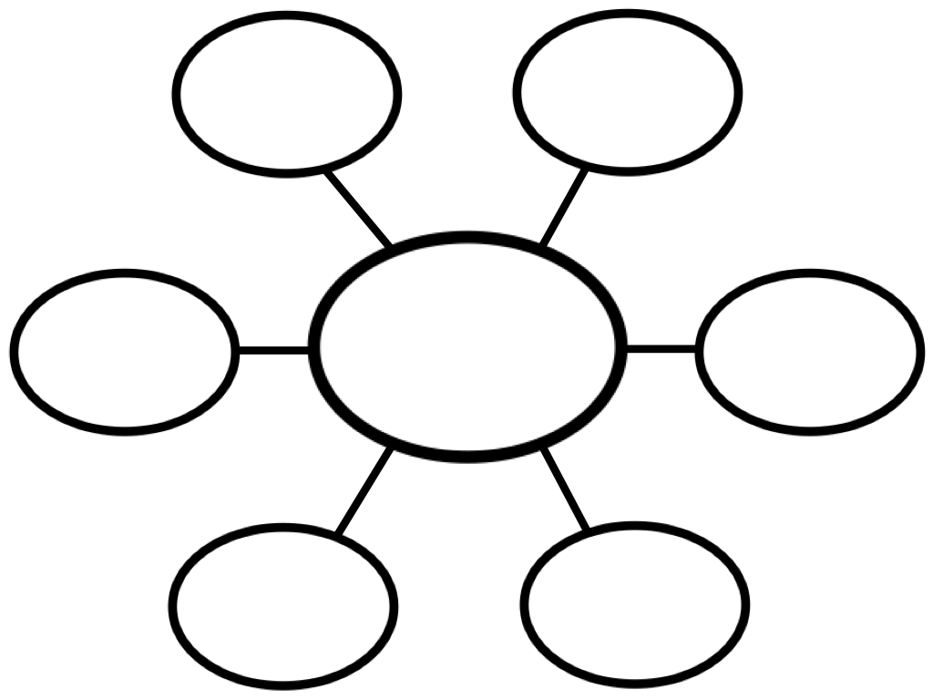
Recollections of Childhood – Starting Out
Going back to the things we did as children can bring back some great memories.
On a piece of paper, map some key recollections of your childhood using a word web. Consider the important places, experiences, and people of your childhood.

Slide 40
My Hometown – Bruce Springsteen
In the following song/poem make not of the following:
Who is the speaker? (stanza 1)
What is the subject? (stanza 1)
What is the speaker’s tone? (stanza 1)
What is the overall mood? (stanza 2)
What images stand out in your mind? (stanza 3)
Identify figurative language and literary devices
What is the form?
What is the theme?

Slide 41
MY HOMETOWN
I was eight years old and running with a dime in my hand Into the bus stop to pick up a paper for my old man I'd sit on his lap in that big old Buick and steer as we drove through town He'd tousle my hair and say son take a good look around this is your hometown This is your hometown This is your hometown This is your hometown

Slide 42
In '65 tension was running high at my high school There was a lot of fights between the black and white There was nothing you could do Two cars at a light on a Saturday night, in the back seat there was a gun Words were passed in a shotgun blast Troubled times had come, to my hometown My hometown My hometown My hometown

Slide 43
Now Main Street's whitewashed windows and vacant stores Seems like there ain't nobody wants to come down here no more They're closing down the textile mill across the railroad tracks Foreman says these jobs are going boys and they ain't coming back to your hometown Your hometown Your hometown Your hometown

Slide 44
Last night me and Kate we laid in bed talking about getting out Packing up our bags maybe heading south I'm thirty-five, we got a boy of our own now Last night I sat him up behind the wheel and said son take a good look around, this is your hometown

Slide 45
(I Remember) Back Home – Clifton Joseph
Name five things that Joseph remembered from back home. As you listen to the poem, also write down the sources of happiness and oppression in Joseph’s childhood.

Slide 46
(I Remember) Back Home – Clifton Joseph
In the following song/poem make not of the following:
Who is the speaker? (stanza 1)
What is the subject? (stanza 1)
What is the speaker’s tone? (stanza 1)
What is the overall mood? (stanza 2)
What images stand out in your mind? (stanza 3)
Identify figurative language and literary devices
What is the form?
What is the theme?

Slide 47
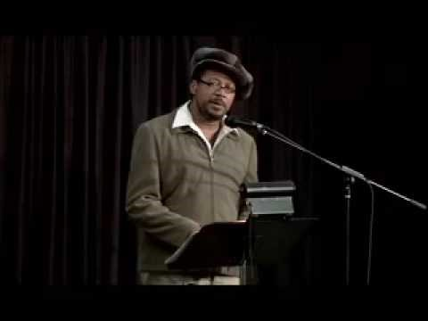
https://www.youtube.com/watch?v=MfU1cDi1hfQ

Slide 48
Deeper Thinking
What do you think it would have been like to grow up where he did?
How do you think his childhood experiences affected him later in life?
What parts of home to you think he wants to get better?
What parts of your home or neighbourhood would you like to see get better?

Slide 49
“My Hometown” by Bruce Springsteen & “(I Remember) Back Home” by Clifton Joseph
Write down this definition for THEME: A broad idea or lesson that is conveyed by a work. The message may be about life, society, or human nature. Themes often explore timeless and universal ideas and may be implied rather than stated implicitly.
What is the theme of the two poems you read/heard?

Slide 50
My Papa’s Waltz – Theodore Roethke
Theodore Roethke was an American poet. His childhood was plagued by the suicide of his uncle and the death of his father when Theodore was 15. Roethke’s trials compelled him to explore his pain though poetry- it was through his tragedies that he discovered his creative life.

Slide 51
My Papa’s Waltz
In your own words, paraphrase the poem
To paraphrase is to restate more simply and clearly the thoughts or meaning of a passage

Slide 52
My Papa’s Waltz
By Theodore Roethke 1908–1963
The whiskey on your breath
Could make a small boy dizzy;
But I hung on like death:
Such waltzing was not easy.
We romped until the pans
Slid from the kitchen shelf;
My mother’s countenance
Could not unfrown itself.
The hand that held my wrist
Was battered on one knuckle;
At every step you missed
My right ear scraped a buckle.
You beat time on my head
With a palm caked hard by dirt,
Then waltzed me off to bed
Still clinging to your shirt.

Slide 53
“Warren Pryor” - Alden Nowlan
Alden Nowlan was born into rural poverty in Stanley, Nova Scotia
His father, Gordon Freeman Nowlan, worked sporadically as a manual labourer.
His mother, Grace Reese, was only 15 years of age when Nowlan was born, and she soon left the family, leaving Alden and her younger daughter Harriet, to the care of their paternal grandmother.
The family discouraged education as a waste of time, and Nowlan left school after only four grades.
At the age of 14, he went to work in the village sawmill.
At the age of 16, Nowlan discovered the regional library.
Each weekend he would walk or hitchhike eighteen miles to the library to get books, and secretly began to educate himself. "I wrote (as I read) in secret."
Nowlan remembered. "My father would as soon have seen me wear lipstick."
His poetry focused on hardships of the every day person

Slide 54
“Warren Pryor” - Alden Nowlan
In the following song/poem make not of the following:
Who is the speaker?
What is the subject?
What is the speaker’s tone?
What is the overall mood?
What images stand out in your mind?
Identify figurative language and literary devices
What is the form?
What is the theme?

Slide 55
Warren Pryor by Alden Nowlan When every pencil meant a sacrifice his parents boarded him at school in town, slaving to free him from the stony fields, the meagre acreage that bore them down. They blushed with pride when, at his graduation, they watched him picking up the slender scroll, his passport from the years of brutal toil and lonely patience in a barren hole. When he went in the Bank their cups ran over. They marvelled how he wore a milk-white shirt work days and jeans on Sundays. He was saved from their thistle-strewn farm and its red dirt. And he said nothing. Hard and serious like a young bear inside his teller's cage, his axe-hewn hands upon the paper bills aching with empty strength and throttled rage.

Slide 56
We have read a little on the great Canadian poet Alden Nowlan. You will be completing an analysis on your own for Nowlan’s poem ‘Warren Pryor’. Read the poem from start to finish slowly in your head. Analyze, interpret and really think about what the author is trying to share with you!
Underneath each line of the poem write what you believe Nowlan is trying to communicate to you, the reader. This can be done in point form. However, please remember that you do not always use end punctuation when writing in short form. Follow all proper English grammar and spelling.
NOTE: You can use the notes and examples you took in class. However, you cannot connect to the Internet during this time.

Slide 57
Poetry Analysis - “Warren Pryor”
Please complete the following assignment and hand it in next class.
Notes:
Hand out assignment (desktop/ela 20/ poetry analysis warren pryor)

Slide 58
Poetry unit exam…
On your exam you will have
Poetic terminology
Figurative language terminology
Poetry analysis – you will be given a poem for which you need to analyze
Questions on poetic elements
A literary comparison between “Papa’s Waltz” and “Warren Pryor” using the 11-sentence paragraph format
Notes:
Hand out 11 – sentence paragraph handout (desktop/ENG 20/11+point+paragraph)

